Slide 1
Intro to Quantitative Trading
Amherst College Quant Trading Club 10/03/19
Eddie Shen, Michael Bakshandeh, Shu Amano

Slide 2
Work Delegation
Strategy researcher / Trader
Most firms differentiate between the two, some don’t
Developer
Operations

Slide 3
Types of Projects/Work
Core trading:
Market data parser
Core trading strategy (i.e. logic of when to buy and sell)
Order gateway
Support trading:
Monitoring GUIs
Position confirmation
Market data capture (for when strategy is executed)
Launching scripts -- booting up the system is very complicated

Slide 4
Types of Projects/Work (cont.)
Research
Parameter optimization
Reconciliation i.e. confirming that the strategy executed as it’s supposed to
Backtesting
Graphing (historical and/or real time)

Slide 5
Overview of Strategies
Arbitrage
Market-taking
Market-making

Slide 6
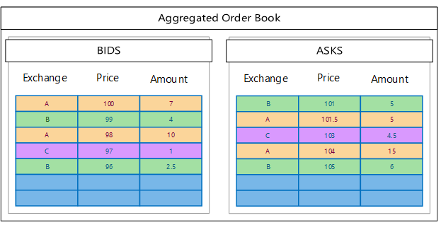

Slide 7
Arbitrage
Lots of financial economic theory on this that I’m not an expert in
Discovering price discrepancies or mispriced securities
Keys to being good at arbitrage
Scale (some call it price impact): managing positions
Speed: affects your ability to hedge on related markets
Queue position: hitting desired level in the order book; in joint with speed

Slide 8
Market-Taking
Buy and pray
Key is to properly price the relative value of securities; predictive signals
Pay to “cross the spread”
e.g. Common strategy: buy the remaining liquidity at an acceptable price after a large buy trade by another player

Slide 9
Market-Making
Very common; most big players are market-makers
Post passive, non-marketable buy and sell orders to profit from spread
Connect buyers and sellers who do not arrive at the same time and get compensated for holding risk for an extended time e.g. more people fill your buy orders than sell orders

Slide 10
Differences Between Companies
How they divide up teams (competition vs. collab)
What exchange, which products
What strategies and how they’re optimized
Frequency/latency-oriented
Statistics-oriented
Fundamental-oriented
How tech-focused they are
& Case Studies of Some
Note: This is very coarse!

Slide 11

Market Maker and/or Trading Firm
Multiple teams working on similar asset classes and strategies
e.g. 15 order-book-pressure alphas
20% fire rate each year
Known for high-frequency but now operating in many products
Largest and leading equities market maker on the NYSE, also largest options market maker on the CME
Researcher - trader - developer setup
Similar firms: Jump Trading, Tower Research, Headlands Tech, Virtu Financial, Optiver, etc.

Slide 12

Tech-company-like Trading Firm / Hedge Fund
Largest ETF market-maker in the US
Focus on high-frequency by being extremely technology and engineering-focused
Researcher-trader-developer setup with developer playing a central role
Very focused on arbitrage, near-zero manual trades
Similar firms: IMC Financial Markets, Two Sigma, Hudson River Trading, Five Rings Capital, etc.

Slide 13

Quantitative Hedge Fund
A hedge fund/mutual fund, NOT a trading firm
Longer horizons
Fundamental driven
Investment philosophy originates from financial economics
Traders are executional; developers are auxiliary, and researchers are core
2nd largest hedge fund behind Bridgewater Associates
Similar firms: Bridgewater, D.E. Shaw, Man Group, Winton Group, Cubist Systematic Strategies (Point72), etc.

Slide 14

A-bit-traditional Trading Firms
One of the first and still largest options market makers
Very manually driven and supported by traditional financial analysis
Loves to host poker competitions and other brain-teasing-game-competitions
Primarily driven by market-making, very little arbitrage, almost no market-taking
Similar firms: Flow Traders, etc.

Slide 15

Investment Banks
Less technologically advanced
Still dominant in OTC products and are moving to automate market making
Not allowed to take principal position due to regulations (Volcker Rule)
Trader/researcher 2-in-1 roles (e.g. GS Strats) and quantitative researcher roles both exist
Some separately hold their own asset management arms (e.g. Credit Suisse QT Fund, GSAM, JPMAM)
Similar firms: J.P. Morgan, Morgan Stanley, Credit Suisse, Barclays, etc.

Slide 16
Know the basic landscape of the industry and find your edge -> place!

Slide 17
Questions? Feedback?

